Slide 1
Provence Rosé
History, Location
Tasting, Wines and Vineyards
Culture, Economy, Lifestyle

Slide 2
When, Where, Who
2,600 years ago
Mediterranean coast- Marseille/Masssilia /Phoenicia
Greeks, then Romans
5th-12C Popes, Abbeys
Provence wine first produced and sold
14C Vineyards bought by Nobility, High ranking military
1880 Phylloxera devastation, solution
40% Vineyards destroyed, Domaine Ott began
20C Provence Rosé Industry Renaissance
Co-operative movement
1935 Oenolgy recognised Science
1955 Crus Classés - 25 named 18 remain today
1977 AOC Cotes de Provence

Slide 3
Where, Who
Var, Bouches de Rhone, Alpes Maritimes
4 AOC, 13 AOP, (26% BIO 69% AOP)
Cotes de Provence
Coteaux Varois
Coteaux d’Aix en Provence
Bandol
440 Domaines and Cellars (Var)

Slide 4
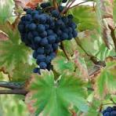
Grape Varieties (Cépage)
Mourvèdre
Syrah
Cinsault
Grenache
Carignan
Cabernet Sauvignon
Tibouren
Terroir – driven production, Climate sensitive, Geological influence

Slide 5
Aldi Wins!
Entry Level Provence Rose
Price competitive- £8.49
Bottled
By Chassaux et Fils
Signature for Aldi-since 2017
Silver Medal
Cepage Grenache ,Cinsault

Slide 6
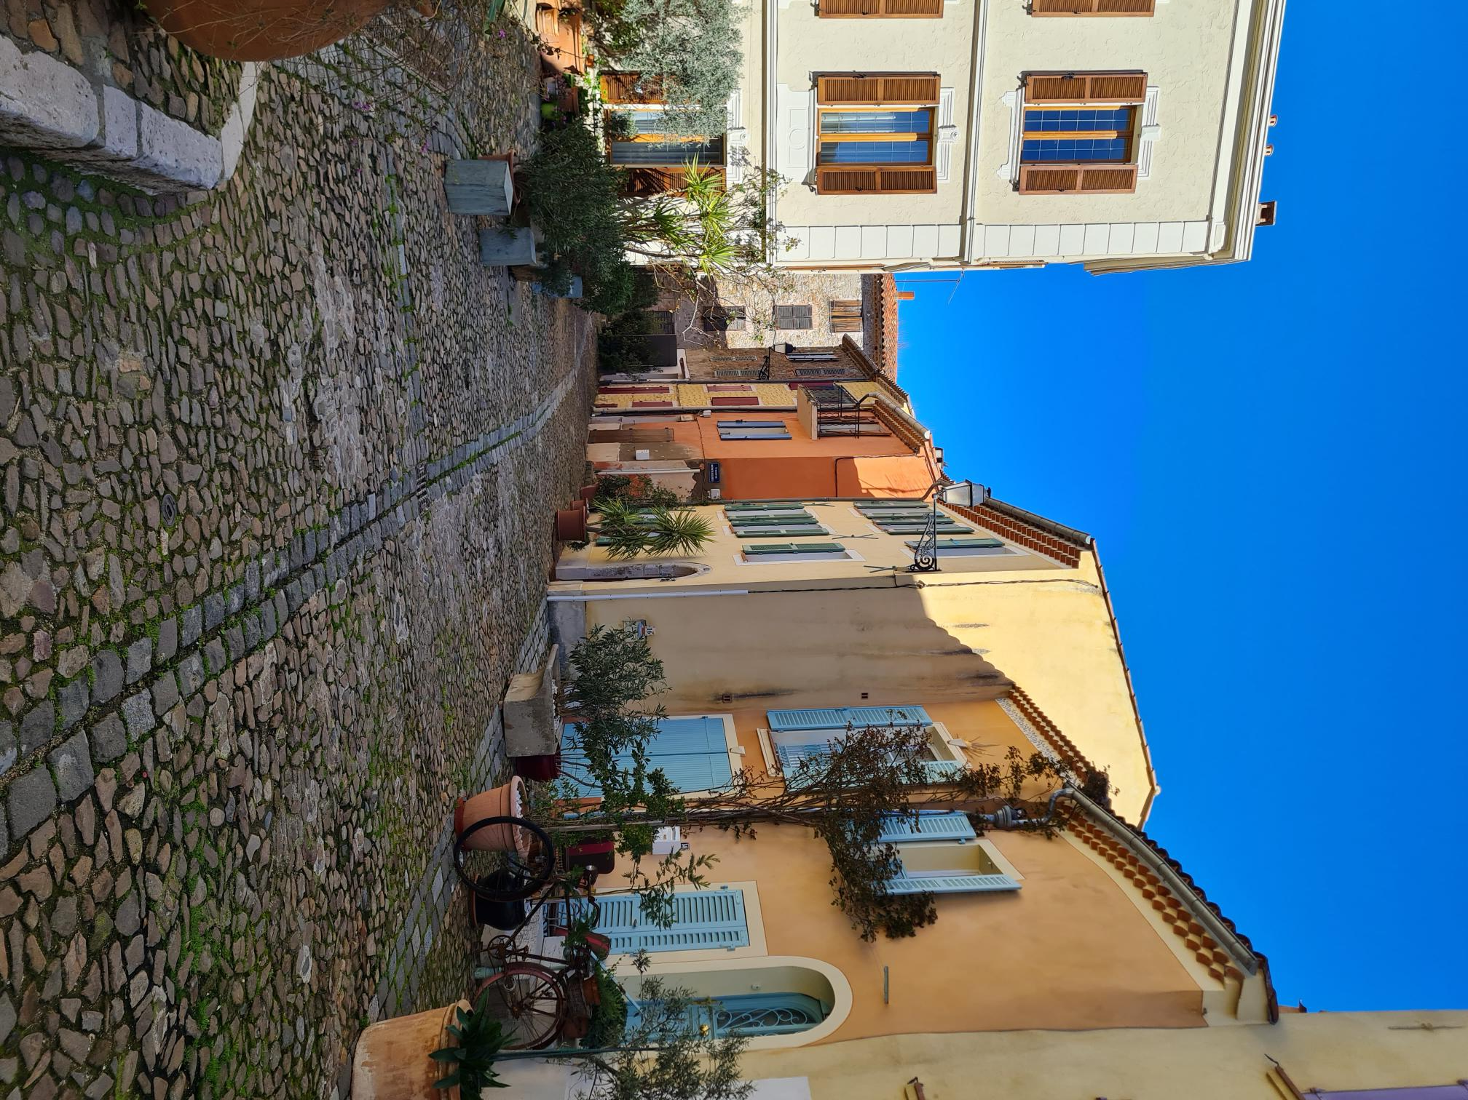
Les Grès
15 Hectares Domaine
Cave des Vignerons, Collobrières
40 Vignerons
200 hectares

Slide 7
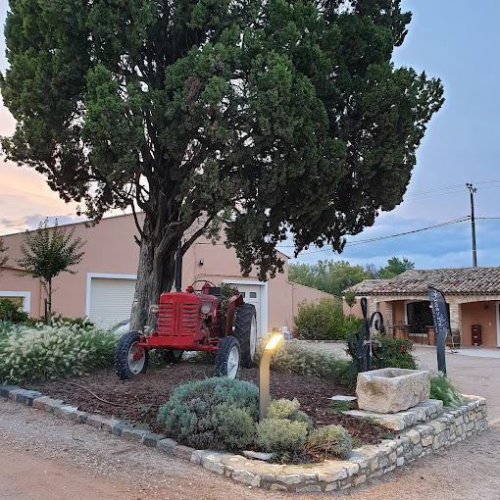
Sainte Croix Gourmandise Villa des Anges

Slide 8
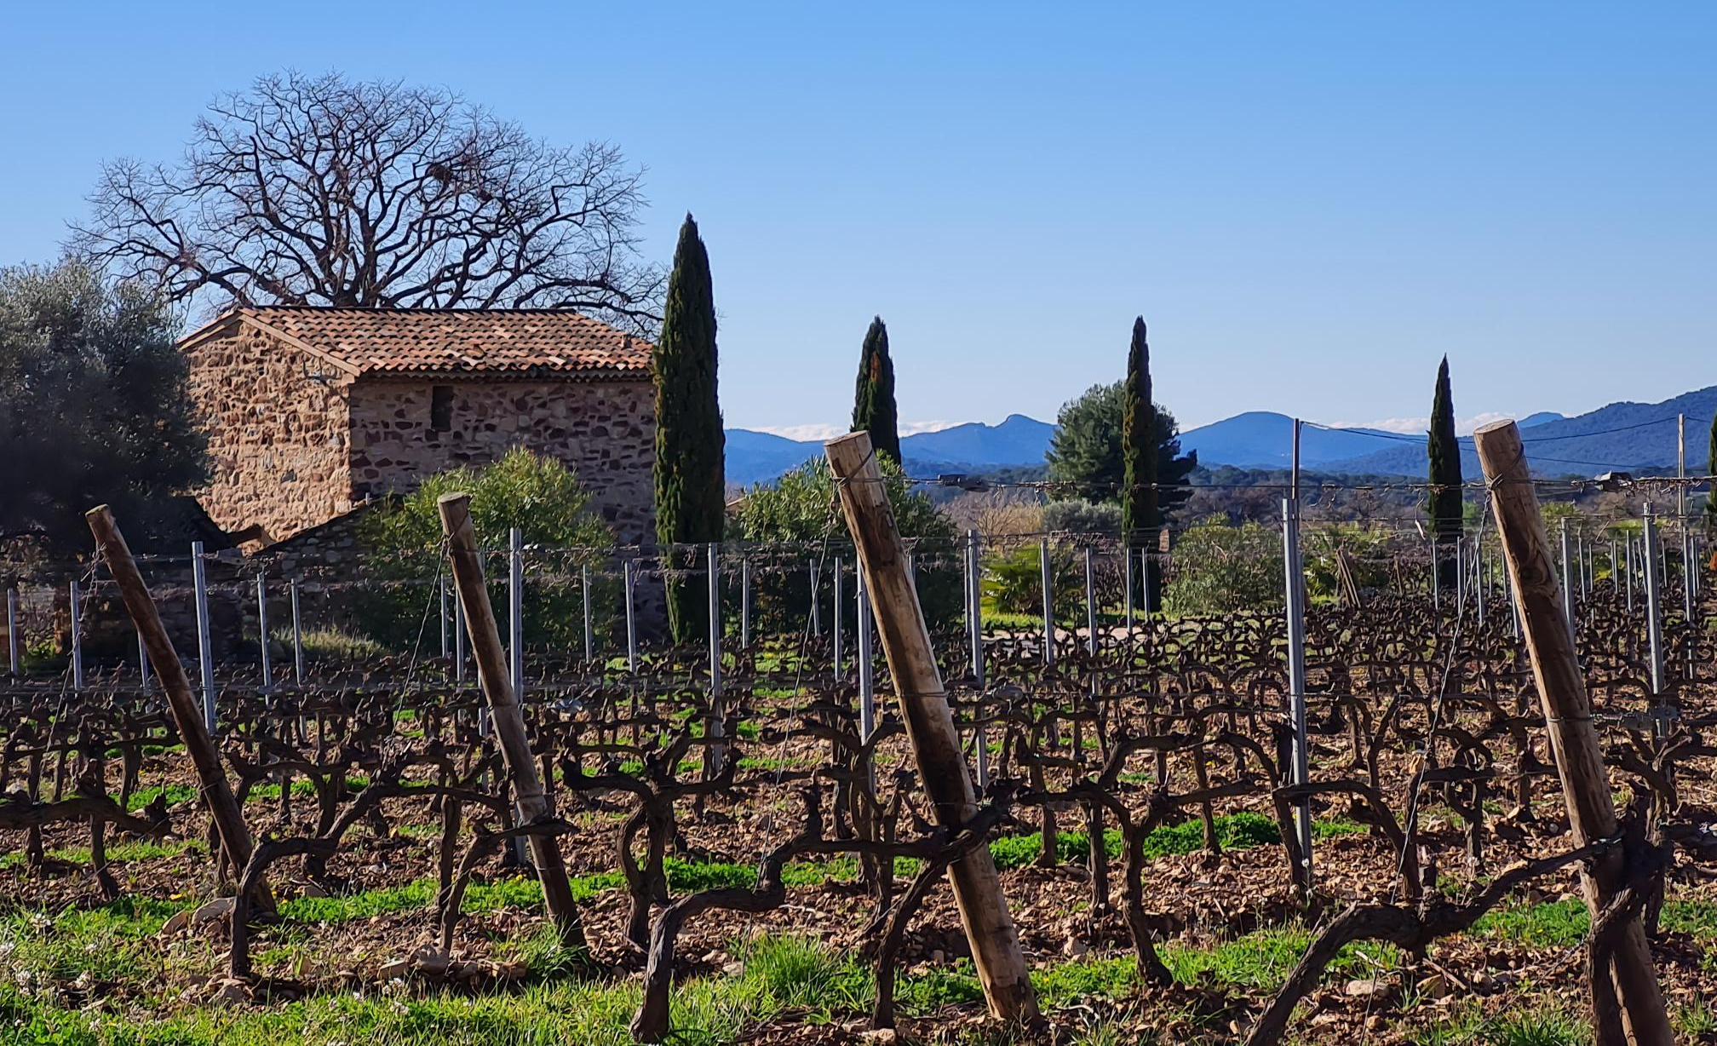
Bastide des Deux Lunes Bertrand Dubois-Pierrefeu-BIO

Slide 9
Bandol, Moulin de la Roque
Co-operative since 1990
4 different vineyards and families
50 Hectares of vines
Keeping 5-6 years
World-renowned

Slide 10
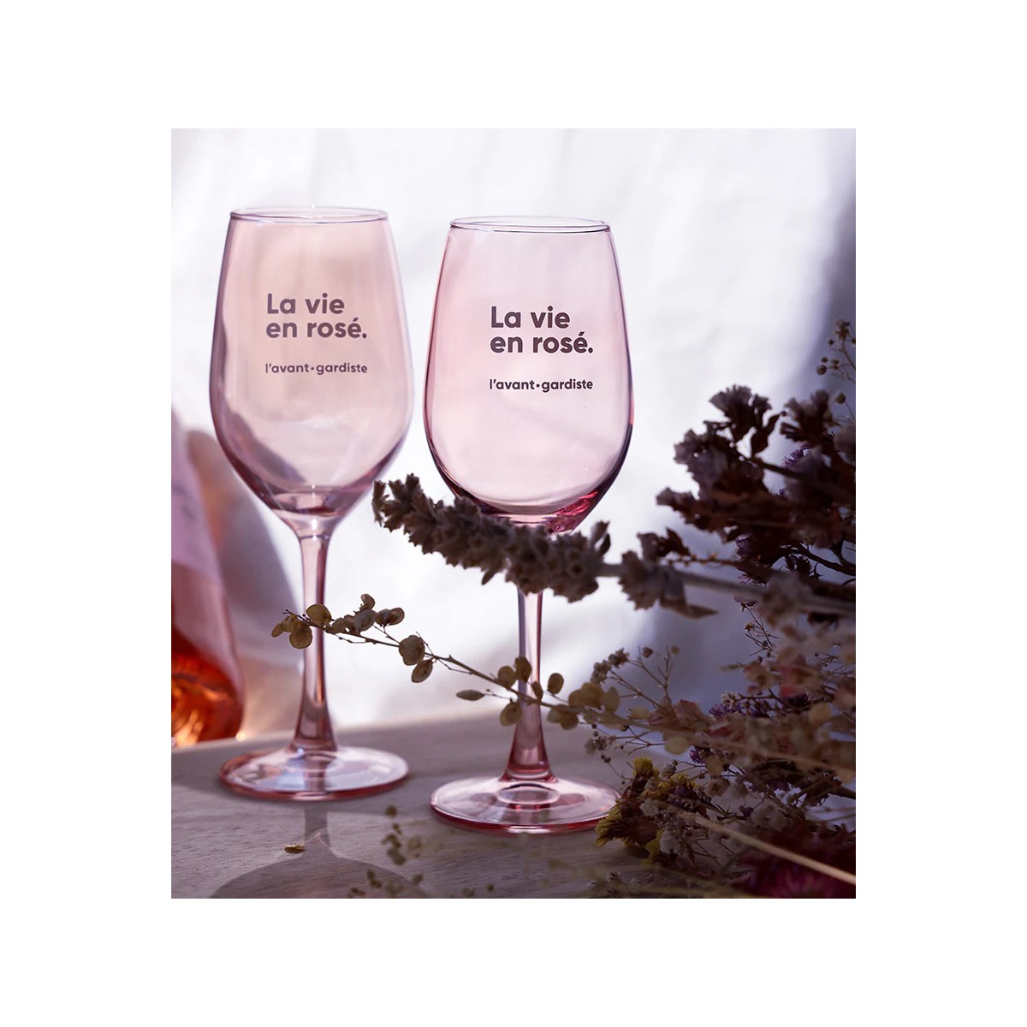
Culture, Economy, Lifestyle
Rose born in Provence- nearly 3000 years ago
Advances in production, suitable for climate​
Complements Mediterranean food​
1/3 glasses consumed in France​
International Market x 5 in 12 Years​
Continued increase in production up to 2022
Export 12% less 2023 but + 6% in value​
35% World production is Provence Rose
BUT, IT’S THE LIFESTYLE THAT COUNTS....

